Slide 1

CHAMPIONS LEAGUE GLORY : STATS AND LEGENDS
ABHINANDH KE

Slide 2

INTRODUCTION
This Tableau dashboard provides a comprehensive overview of the UEFA Champions League by analyzing key performance metrics across players, clubs, coaches, and countries. It highlights scoring records, appearances, titles, and competitive dominance, transforming historical football data into clear, interactive insights for analysis and comparison

Slide 3
OBJECTIVES
Compare all-time top scorers and seasonal goal trends
Rank clubs by titles won and matches played
Analyze player appearances and long-term consistency
Evaluate top coaches based on achievements and appearances
Assess club attacking and defensive performance
Visualize country-wise Champions League dominance

Slide 4
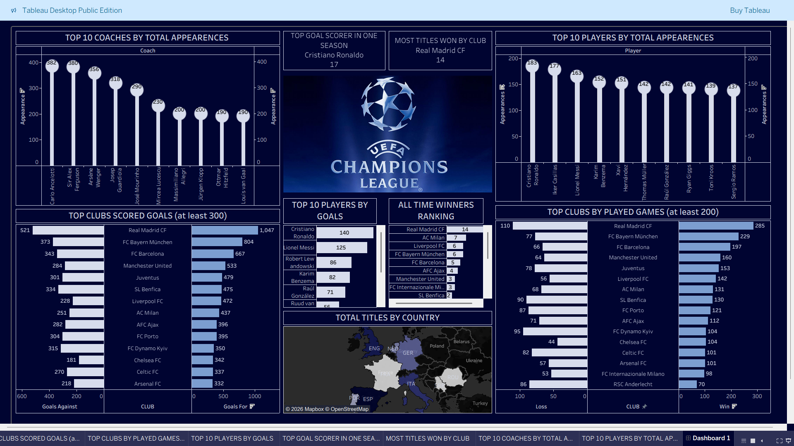

Slide 5
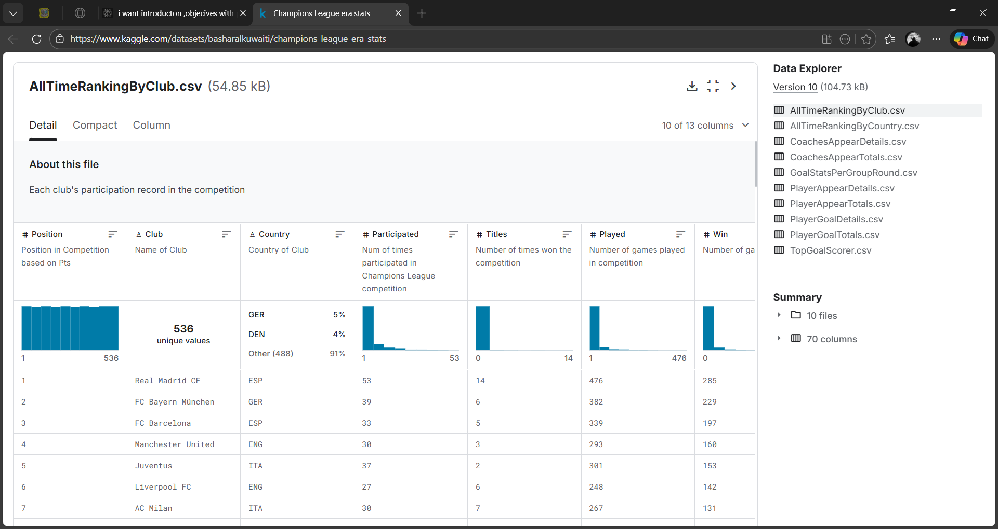

Slide 6
Conclusion
This dashboard brings Champions League football to life by highlighting top goal scorers, most successful clubs, influential managers, and country-wise dominance, allowing fans and analysts to track form, consistency, and legacy, and clearly see how goals, trophies, appearances, and tactics have defined success in Europe’s biggest stage.

Slide 7
THANK YOU…
.

